Slide 1






1-202-983-3002
services@interlinkiq.com
www.InterlinkIQ.com

Slide 2
Purpose
To prevent foodborne illness by contaminated hands.
Scope
This procedure applies to anyone who is in the facility.
Best Practices
Handwashing signs or posters are posted in areas with food preparation, restrooms, and all handwashing sinks in a language that all staff members can understand.
Washing hands at designated handwashing sinks.
Handwashing stations have warm running water, soap, and a means to dry hands. A waste container at each handwashing sink or near the door in restrooms is provided.
Handwashing stations in the facilities are available.
1-202-983-3002
services@interlinkiq.com
www.InterlinkIQ.com

Slide 3
Best Practices
Washing hands
  Before starting work
  During food preparation
  When moving from one food preparation area to another
  Before putting on or changing gloves
  After using the toilet
  After sneezing, coughing, or using a handkerchief or tissue
  After touching hair, face, or body
  After smoking, eating, drinking, or chewing gum or tobacco
  After handling raw meats, poultry, or fish
  After any clean-up activity such as sweeping, mopping, or wiping counters
  After touching dirty dishes, equipment, or utensils
  After handling trash
  After handling money
  After any time the hands may become contaminated
1-202-983-3002
services@interlinkiq.com
www.InterlinkIQ.com

Slide 4
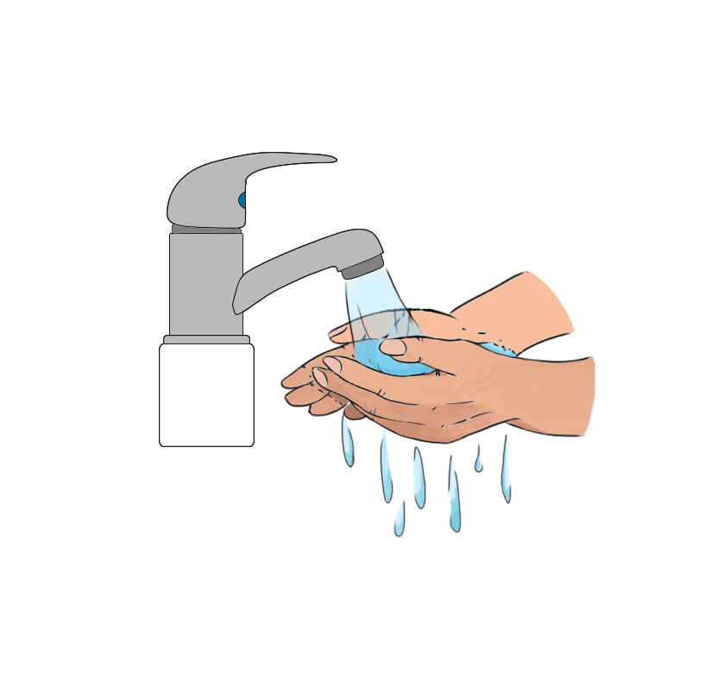
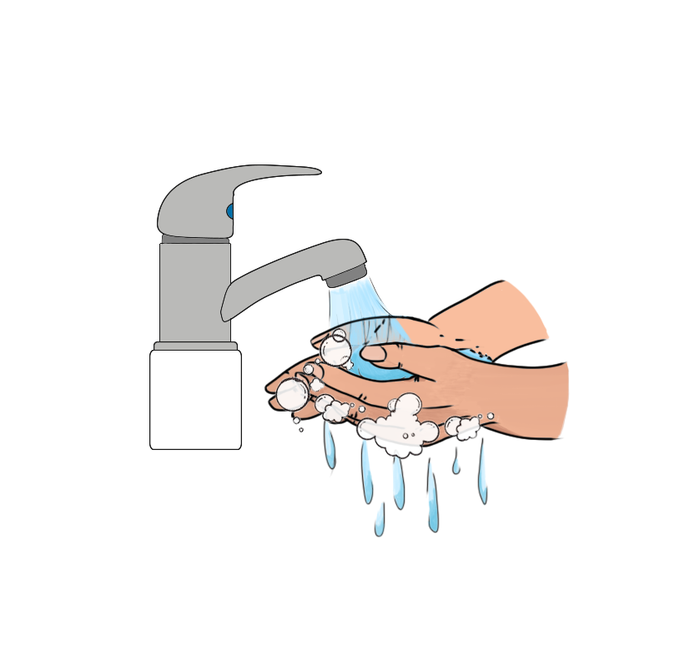
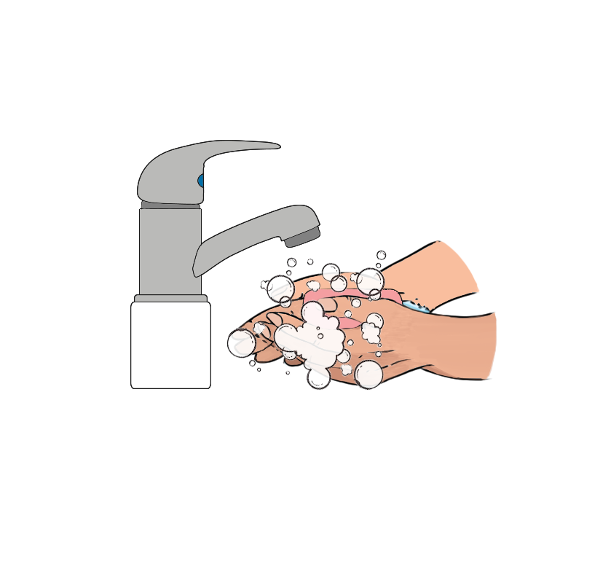
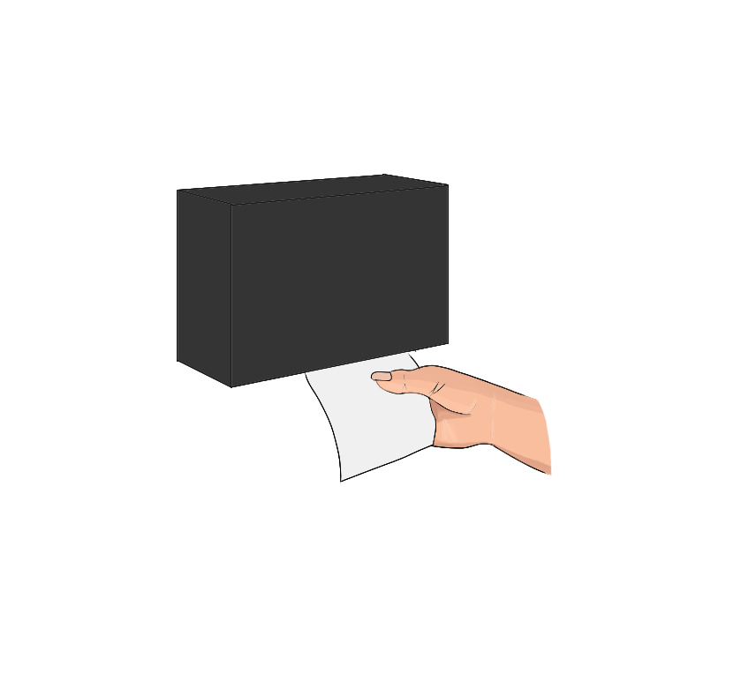
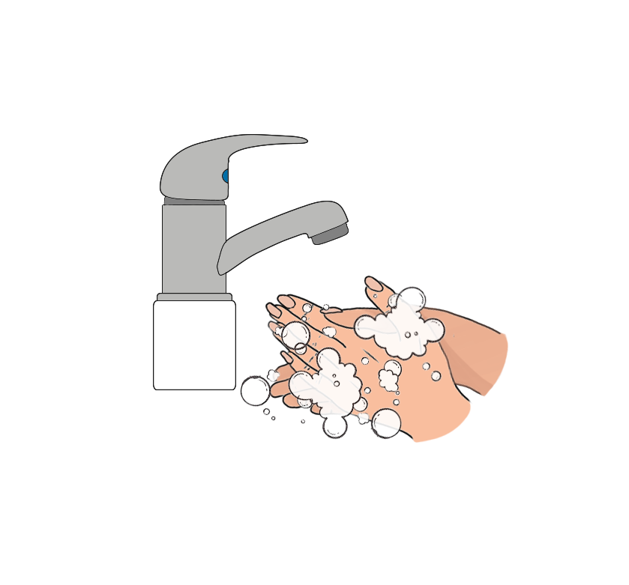
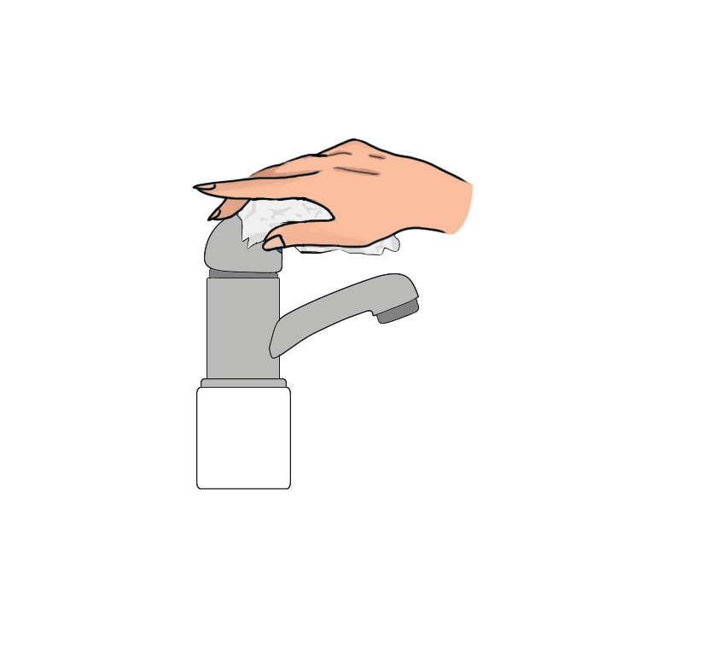
Procedure
Traditional handwashing procedures
Step 1- Wet hands and forearms with warm, running water at least 100 ºF.
Step 4 - Rinse thoroughly under warm running water for 5-10 seconds.
Step 2 - Apply soap
Step 5 - Dry hands and forearms thoroughly with single-use paper towels.
Step 6 - Turn off the water using paper towels.
Step 3 - Scrub lathered hands and forearms, under fingernails, and between fingers for at least 10-15 seconds.
1-202-983-3002
services@interlinkiq.com
www.InterlinkIQ.com

Slide 5
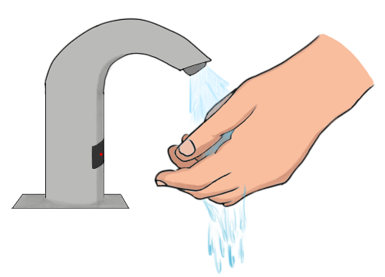
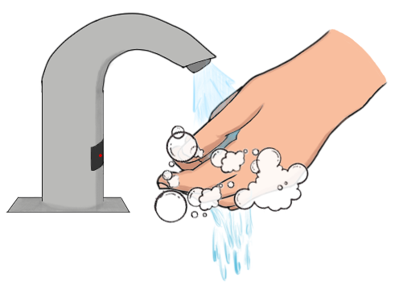
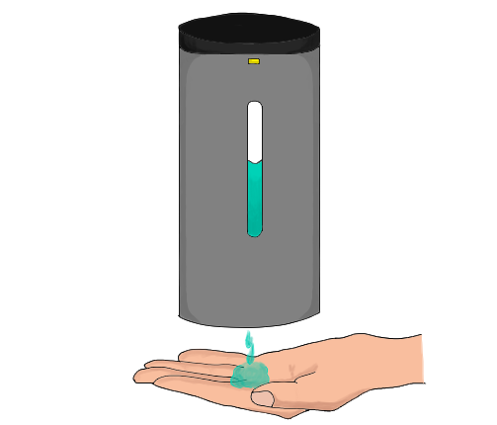
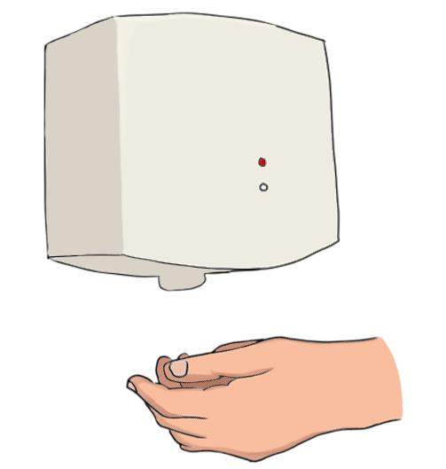
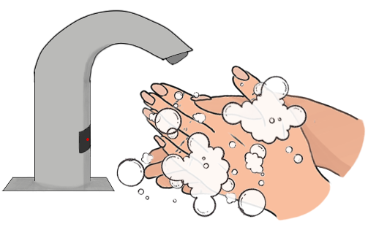
Procedure
Automated handwashing procedures
Step 1 – Place your hands in autodetect faucet to wet your hands and forearms with warm, running water at least 100 ºF.
Step 4 - Rinse thoroughly under warm running water for 5-10 seconds.
Step 2 - Apply soap
Step 5 -
Step 3 - Scrub lathered hands and forearms, under fingernails, and between fingers for at least 10-15 seconds.
1-202-983-3002
services@interlinkiq.com
www.InterlinkIQ.com

Slide 6
Procedure
Automated handwashing procedures
  Wet hands and forearms with warm, running water at least 100 ºF.
  Apply soap
  Scrub lathered hands and forearms, under fingernails, and between fingers for at least 10-15 seconds.
  Rinse thoroughly under warm running water for 5-10 seconds.
  Dry hands and forearms thoroughly with single-use paper towels.
  Turn off the water using paper towels.
1-202-983-3002
services@interlinkiq.com
www.InterlinkIQ.com

